Slide 1

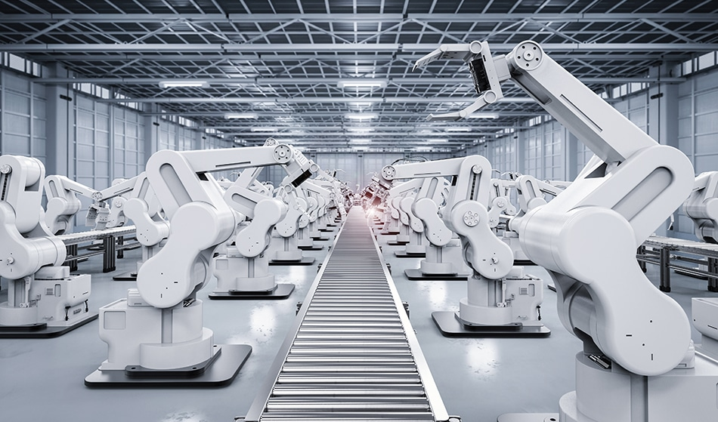
Team 1311 Proposal
Daniil Volodin, Liam Kennedy, Casey Etoka
The Future of employment, Jobs and work through automation of Industrial Robots.
As technology advances the need of faster solutions to modern requirements escalate. Automation has been a key development in recent history through many facets including manufacturing, research and data entry collecting, delivery services and more.
We chose this topic because we want to know how this persistent need of self-regulated and self-automated technology will affect societies future employment and especially our own, seeing as most of us will be dealing with the idea of automation during our prospective careers. We especially wanted to see the impact of Industrial robots have had and are continuing to have on employment since this progression of technology will see different outcomes for society, where some will greatly benefit, while others will be expendable to the constant evolution.
https://www.azorobotics.com/Article.aspx?ArticleID=19
Summary of Team Roles:
Daniil
Project manager:
Gives general idea to how we will set up our project with a clear structure
Casey
Time Management
Sets up meeting time and keeps members liable to the work there supposed to be doing.
Liam
Concept design and research
Creation of concepts and ideas that could be included in the assignment and website.
Although all of us will transition between roles when needed as the project develops to evenly distribute the work load
Description: The industrial robot is a form of a machine that is automated to perform tasks in a specific industrial environment. Most common forms of industrial robot automation include welding, handling, packaging, picking, dispensing and cutting.
Link to the source: https://www.youtube.com/watch?v=Cndodc3X50s
Relevance: Throughout the years, industrial robots have evolved to the point they are taking over jobs that required man labor in the past. The industrial robots are relevant until this day because of the lower cost, maintenance and productivity efficiency they provide.
Student ID: 21143508, 21145753, 21141402

